Slide 1
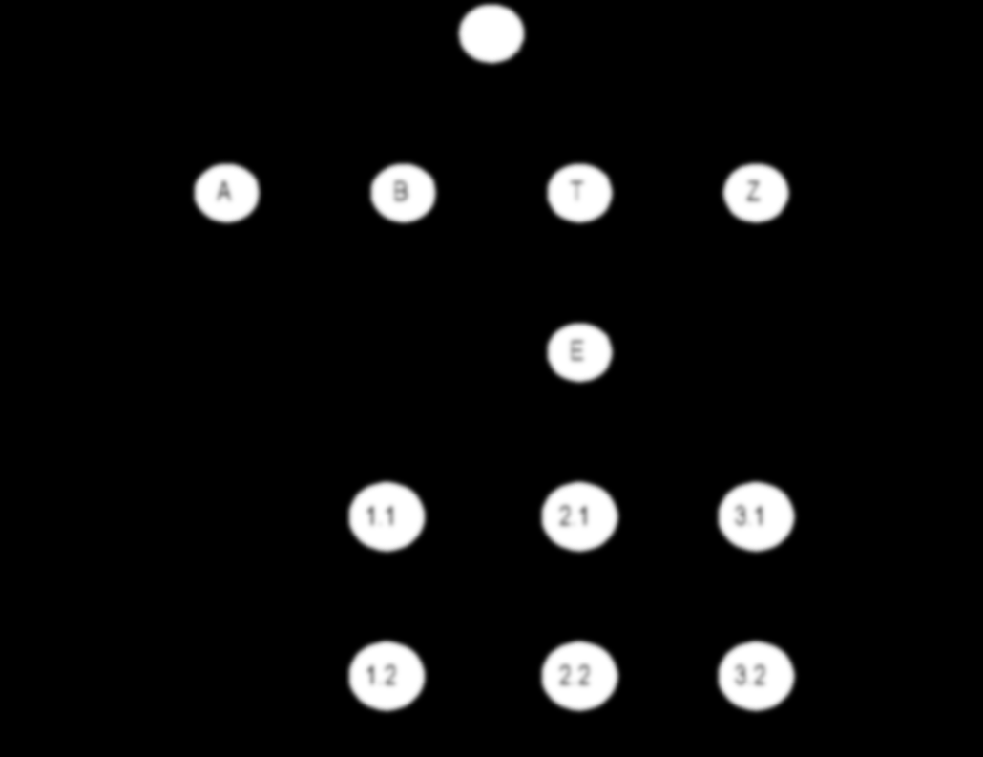
Chapter 5 SNMPv1 Network Management: Communication and Functional Models
Chapter 5
Week 4
SNMPv1 Network Management:
Communication and Functional Models

Slide 2
Objectives
Chapter 5 SNMPv1 Network Management: Communication and Functional Models
Communication model: Administrative and messages
Administrative structure
  Community-based model
  Access policy
  MIB view
Message PDU
SNMP protocol specifications
SNMP operations
SNMP MIB
SNMP functional model
Student manual
Chapter 5 All sections
We have covered the organization and information models of SNMPvl in the previous chapter. In this chapter we will address the SNMPvl communication and functional models.
The SNMPvl communication model defines specifications of four aspects of SNMP communication: architecture, administrative model that defines data access policy, SNMP protocol, and SNMP MIB.
Security in SNMP is managed by defining community, and only members belonging to the same community can communicate with each other. A manager can belong to multiple communities and can thus manage multiple domains.

Slide 3
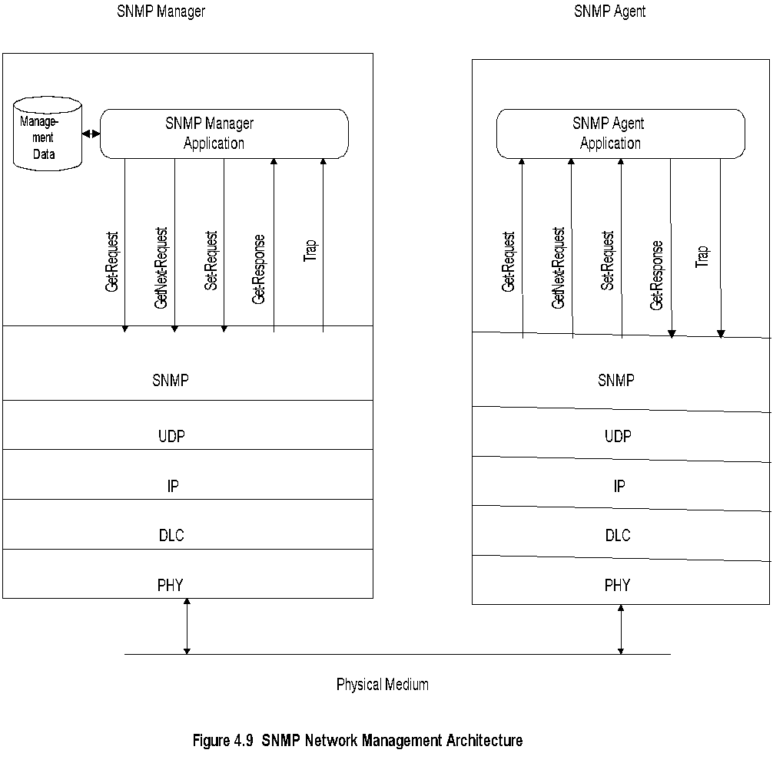
SNMP Architecture
The SNMP communications protocol is used to communicate information between network management stations and management agents in the elements.
There are three goals of the architecture in the original specifications of SNMP:
First, it should minimize the number and complexity of management functions realized by the management agent.
Secondly, it should be flexible for future expansion.
Lastly, the architecture should be independent of architecture and mechanisms of particular hosts and gateways.
Notes
Truly simple network management protocol
Five messages, 3 from manager and 2 from agent

Slide 4
Chapter 5 SNMPv1 Network Management: Communication and Functional Models
Get-Request
Get-Next-Request
Set-Request
Get-Response
Trap
  Generic trap
  Specific trap
  Time stamp
SNMP Messages
Information about the network is primarily obtained by the management stations polling the agents. The get-request and get-next-request messages are generated by the manager to retrieve data from network elements using associated management agents. The set-request is used to initialize and edit network element parameters. The get-response-request is the response from the agent to get and set messages from the manager. The number of unsolicited messages in the form of traps is limited to make the architecture simple and to minimize traffic.
There are three types of traps — generic-trap, specific-trap, and time-stamp, which are application specific.
The generic-trap type consists of coldStart, warmStart, linkDown, linkUp, authentication Failure, egpNeighborLoss, and enterpriseSpecific.
The specific-trap is a specific code and is generated even when an enterpriseSpecific trap is not present. An example of this would be to gather statistics whenever a particular event occurs, such as use by a particular group.
The time-stamp trap is the time elapsed between the last initialization or re-initialization of the element and the generation of the trap.
SNMP messages are exchanged using a connectionless UDP transport protocol in order to be consistent with simplicity of the model, as well as to reduce traffic. However, the mechanisms of SNMP are suitable for a variety of protocols.
Notes
Generic trap
  coldStart
  warmStart
  linkDown
  linkUp
  authenticationfailure
  egpNeighborLoss
  enterpriseSpecific
Specific trap
  For special measurements such as statistics
Time stamp: Time since last initialization

Slide 5
Chapter 5 SNMPv1 Network Management: Communication and Functional Models
Administrative Model
Based on community profile and policy
SNMP Entities:
  SNMP application entities
  - Reside in management stations and network elements
  - Manager and agent
  SNMP protocol entities
  - Communication processes (PDU handlers)
  - Peer processes that support application entities
Notes
To understand the administrative relationship among entities that participate in the communication protocol in SNMP.
The entities residing in management stations and network elements are called SNMP application entities. We will refer to the application entity residing in the management station as the SNMP manager, and the application entity in the element as the SNMP agent.
  The pairing of the two entities is called an SNMP community.

Slide 6
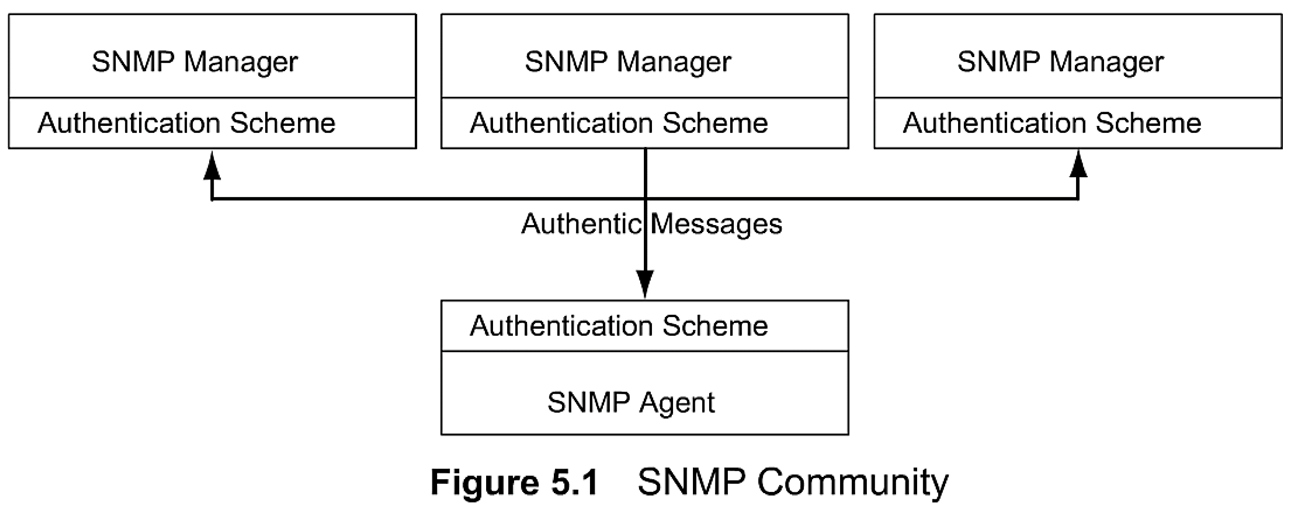
Chapter 5 SNMPv1 Network Management: Communication and Functional Models
SNMP Community
Figure 5.1 shows multiple SNMP managers communicating with a single SNMP agent. While an SNMP manager is monitoring traffic on an element, another manager may be configuring some administrative information on it. A third manager can be monitoring it to perform some statistical study. We also have the analogous situation where a manager communicates with multiple agents.
Notes
Security in SNMPv1 is community-based
Authentication scheme in manager and agent
Community: Pairing of two application entities
Community name: String of octets
Two applications in the same community communicate with each other
Application could have multiple community names
Communication is not secured in SNMPv1 - no encryption
The simplest form of authentication is the common community name between the two application entities. Encryption would be a higher level of authentication in which case both the source and the receiver know the common encryption and decryption algorithms.

Slide 7
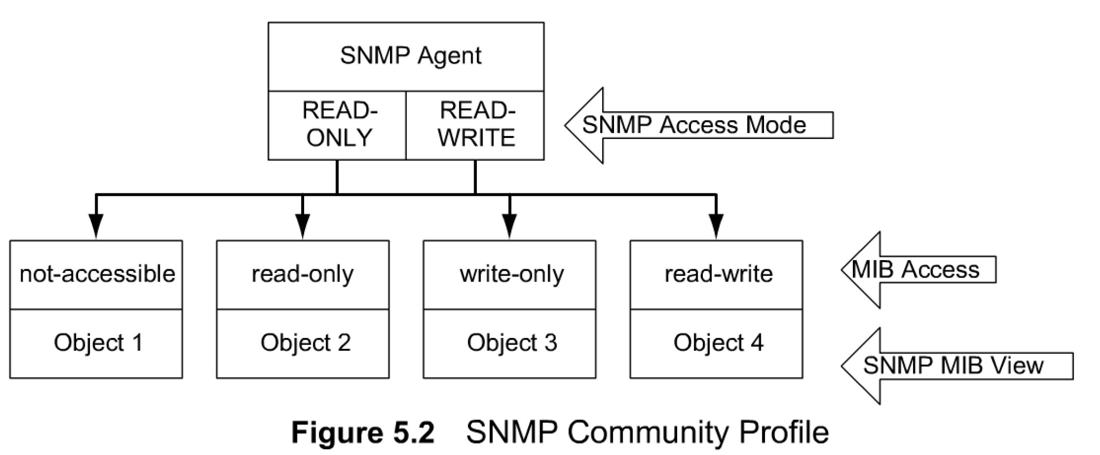
Chapter 5 SNMPv1 Network Management: Communication and Functional Models
Community Profile
MIB view
  An agent is programmed to view only a subset
  of managed objects of a network element
Access mode
  Each community name is assigned an access
  mode: read-only and read-write
Community profile: MIB view + SNMP access mode
Operations on an object determined by community
profile and the access mode of the object
Total of four access privileges
Some objects, such as table and table entry are
non-accessible
The SNMP authorization is implemented as part of managed object MIB specifications.
A network element comprises many managed objects — both standard and private. However, a management agent may be permitted to view only a subset of the network element's managed objects. This is called the community MIB view.
In Figure 5.2 the SNMP agent has a MIB view of objects 2, 3, and 4, although there may be other objects associated with a network element. In addition to the MIB view, each community name is also assigned an SNMP access mode, either READ-ONLY or READ-WRITE, as shown in Figure 5.2.
A pairing of SNMP MIB views with an SNMP access code is called a community profile.
A community profile in combination with the access mode of a managed object determines the operation that can be performed on the object by an agent. For example, in Figure 5.2, an SNMP agent with READ-WRITE SNMP access mode can perform all operations—get, set, and trap—on objects 2, 3, and 4. On the other hand, if the SNMP agent has READ-ONLY access mode privilege, it can only perform get and trap operations on objects 2, 3, and 4. Object 1 has a "not-accessible" access mode and hence no operation can be performed on it.

Slide 8
Chapter 5 SNMPv1 Network Management: Communication and Functional Models
SNMP Community
Security in SNMPv1 is community-based
Authentication scheme in manager and agent
Community: Pairing of two application entities Community name: String of octets
Two applications in the same community communicate with each other
Communication is not secured in SNMPv1 - no encryption
MIB view
  An agent is programmed to view only a subset
  of managed objects of a network element
Access mode
  Each community name is assigned an access
  mode: read-only and read-write
Community profile: MIB view + SNMP access mode
Operations on an object determined by community
profile and the access mode of the object
Total of four access privileges
Some objects, such as table and table entry are
non-accessible
Community Profile
The SNMP authorization is implemented as part of managed object MIB specifications.
A network element comprises many managed objects — both standard and private. However, a management agent may be permitted to view only a subset of the network element's managed objects. This is called the community MIB view.
In Figure 5.2 the SNMP agent has a MIB view of objects 2, 3, and 4, although there may be other objects associated with a network element. In addition to the MIB view, each community name is also assigned an SNMP access mode, either READ-ONLY or READ-WRITE, as shown in Figure 5.2.
A pairing of SNMP MIB views with an SNMP access code is called a community profile.
A community profile in combination with the access mode of a managed object determines the operation that can be performed on the object by an agent.

Slide 9
Chapter 5 SNMPv1 Network Management: Communication and Functional Models
Administrative Model
Administrative model is SNMP access policy
SNMP community paired with SNMP
community profile is SNMP access policy
Notes
Parameters:
  Community / communities
  Agent / Agents
  Manager / Managers

Slide 10
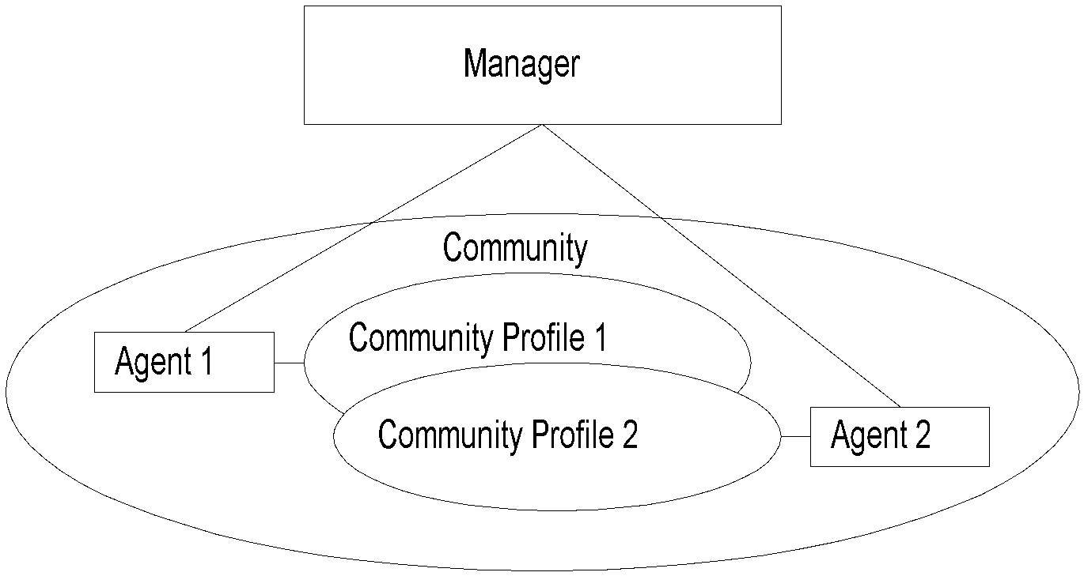
Chapter 5 SNMPv1 Network Management: Communication and Functional Models
Access Policy
It can be extended to managing non-SNMP community
Notes
Manager manages Community 1 and 2 network components via Agents 1 and 2
Agent 1 has only view of Community Profile 1, e.g., Cisco components
Agent 2 has only view of Community Profile 2, e.g., 3Com components
Manager has total view of both Cisco and 3Com components

Slide 11
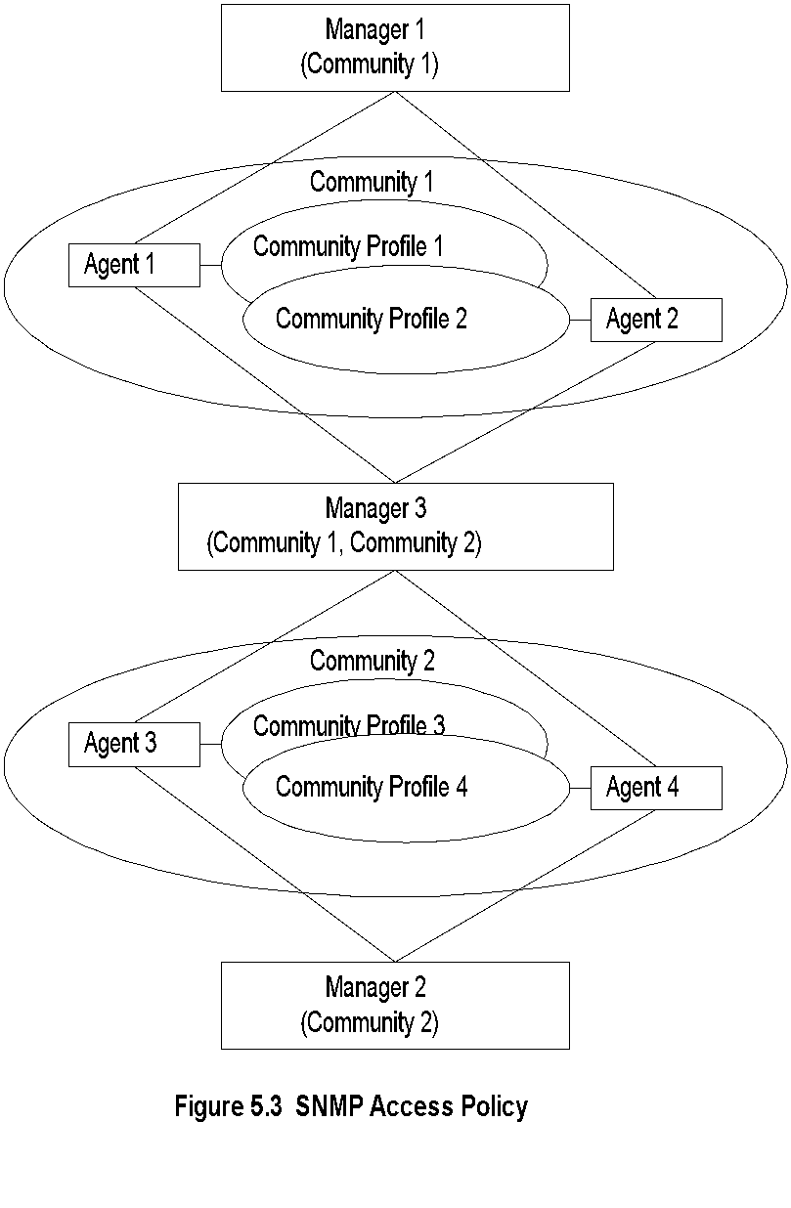
Generalized Administrative Model
Notes
Manager 1 manages community 1, manager 2
community 2, and manager 3 (MoM) both
communities 1 and 2
Network Management: Principles and Practice
© Mani Subramanian 2010
*

Slide 12
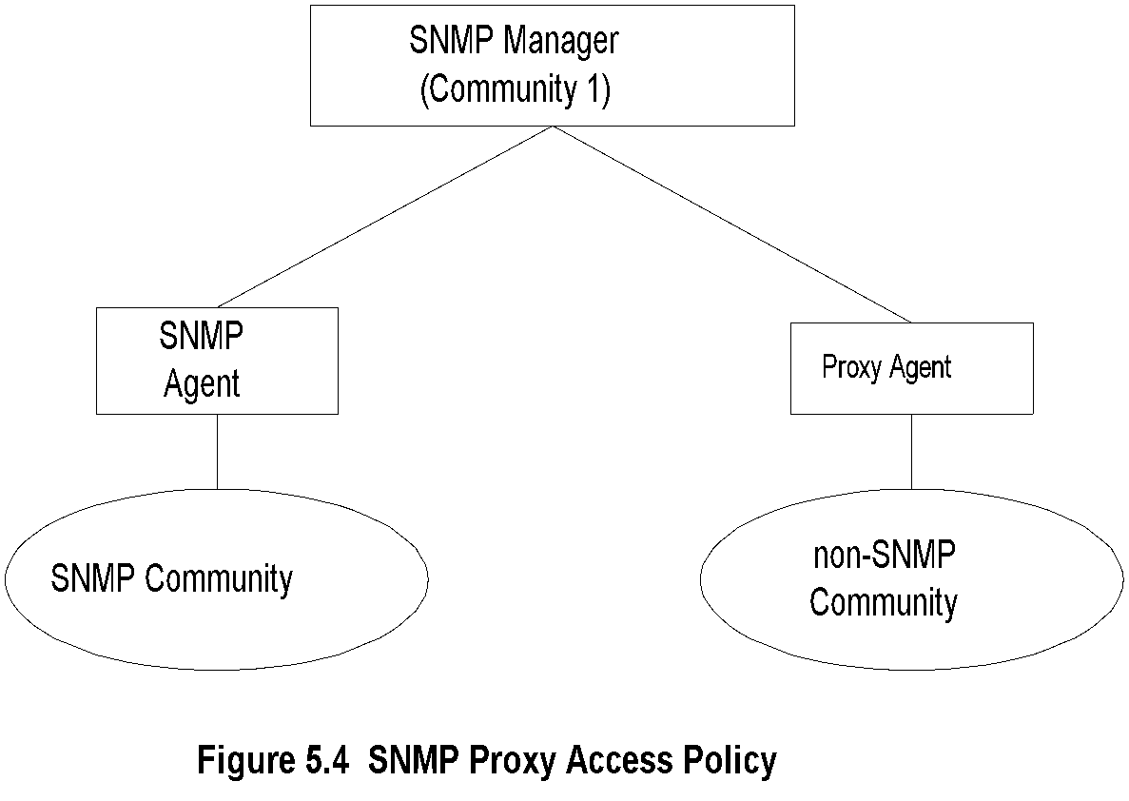
Chapter 5 SNMPv1 Network Management: Communication and Functional Models
Proxy Access Policy
Notes
Proxy agent enables non-SNMP community elements to be managed by an SNMP manager.
An SNMP MIB is created to handle the non-SNMP objects.

Slide 13
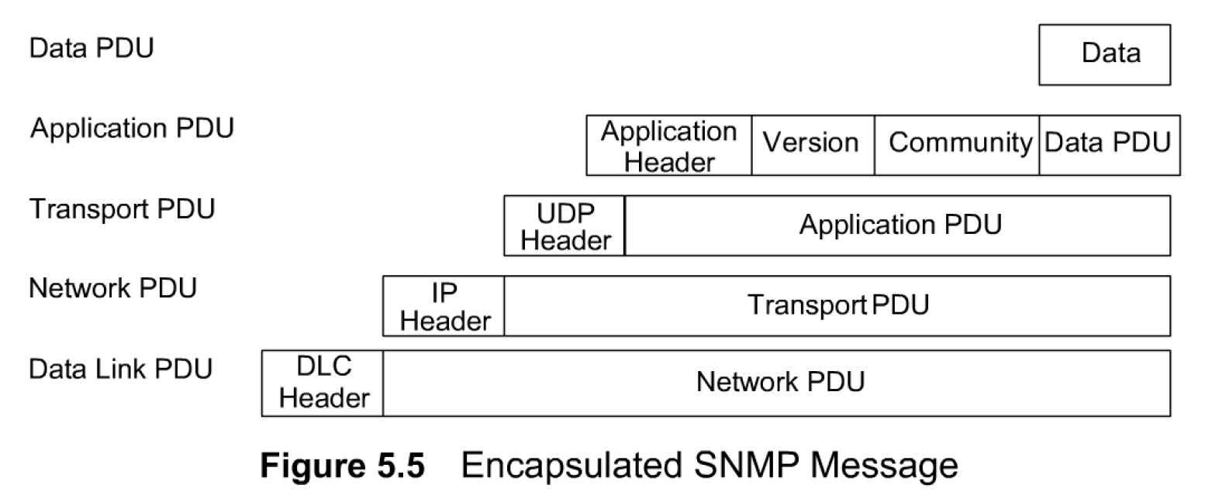
Chapter 5 SNMPv1 Network Management: Communication and Functional Models
Protocol Entities
Peer processes, which implement SNMP, are termed protocol entities. Communication among protocol entities is accomplished using messages encapsulated in a UDP datagram.
Figure 5.5 shows the encapsulated SNMP message. The version and community names are added to the data PDU and along with the application header is passed on to the transport layer as SNMP PDU.
The UDP header is added at the transport layer, which then forms the transport PDU for the network layer. The addition of the IP header to the Transport PDU forms the Network PDU for the data link layer (DLC). The network or DLC header is added before the frame is transmitted on to the physical medium.
An SNMP protocol entity is received on port 161 on the host except for trap, which is received on port 1 62. The maximum length of the protocol in SNMPvl is 484 bytes (1,472 bytes now in practice).
It is mandatory that all five PDUs be supported in all implementations:
GetRequest-PDU, GetNextRequest- PDU, GetResponse-PDU, SetRequest-PDU, and Trap-PDU.
Notes
Protocol entities support application entities
Communication between remote peer processes
Message consists of:
  Version identifier
  Community name
  Protocol Data Unit
Message encapsulated and transmitted
The protocol entity that generates the message constructs the appropriate data PDU as an ASN.l object. It then passes the ASN.l object along with a community name and the transport addresses of itself and the destination (e.g., 123.234.245.156:161) to the authentication scheme. The authentication scheme returns another ASN.l object (possibly encrypted). The protocol entity now constructs the message to be transmitted with the version number, community name, and the new ASN.l object, then serializes it using the BER rules, and transmits it.

Slide 14
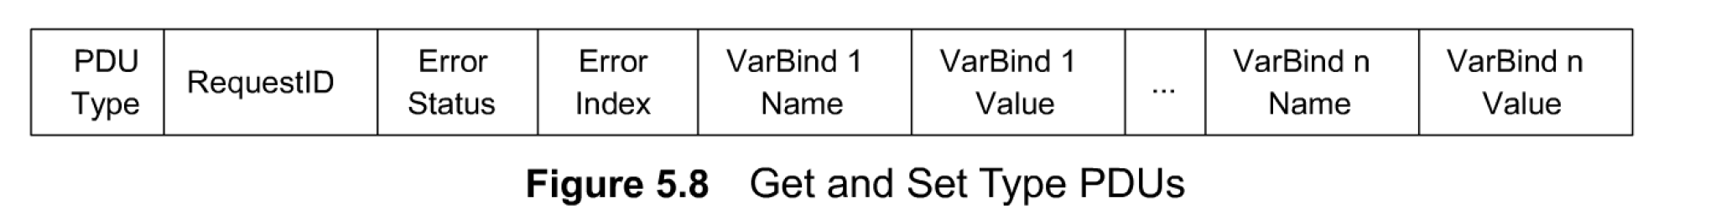
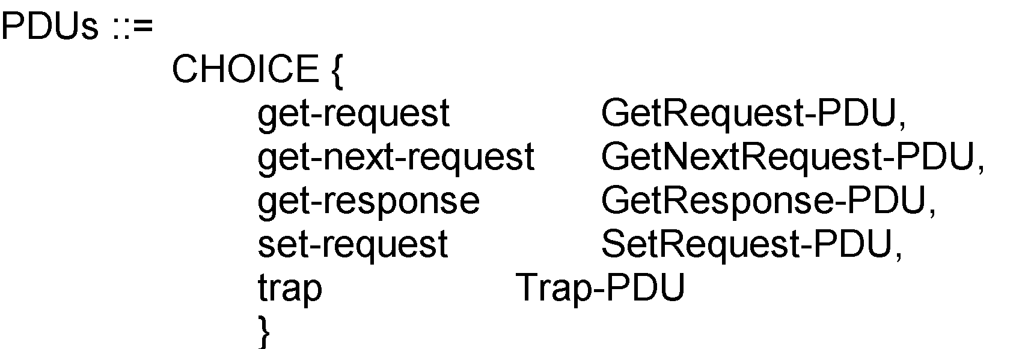
Chapter 5 SNMPv1 Network Management: Communication and Functional Models
Get and Set PDU
In Figure 5.8 RequestID is used to track a message with the expected response or for loss of a message (remember UDP is unreliable). Loss-of-message detection is implementation specific, such as time out if no response is received for a request within a given time. A non-zero Error Status is used to indicate that an error occurred. The convention is not to use 0 if no error is detected. Error index is used to provide additional information on the error status.
The value is filled with NULL in those cases where it is not applicable, such as in get-request data PDU. Otherwise, it is filled with the varBind number where the error occurred; for example, 1 if the error occurred in the first varBind, 5 if the fifth varBind had an error and so on.
Notes
VarBindList: multiple instances of VarBind pairs
A managed object is a scalar variable and is simply called a variable. Associated with the variable is its value.
The pairing of the variable and value is called variable binding or VarBind. The data PDU in the message contains a VarBind pair. For efficiency sake, a list of VarBind pairs can be sent in a message. The ASN.l construct for get and set type of messages and a conceptual presentation in Figure 5.8.
The VarBindList contains n instances of VarBind (pairs).
The PDU type for the five messages are application data types, which are defined as:
get-request [0]
get-next-request [1]
set-request [2]
get-response [3]
trap [4]

Slide 15
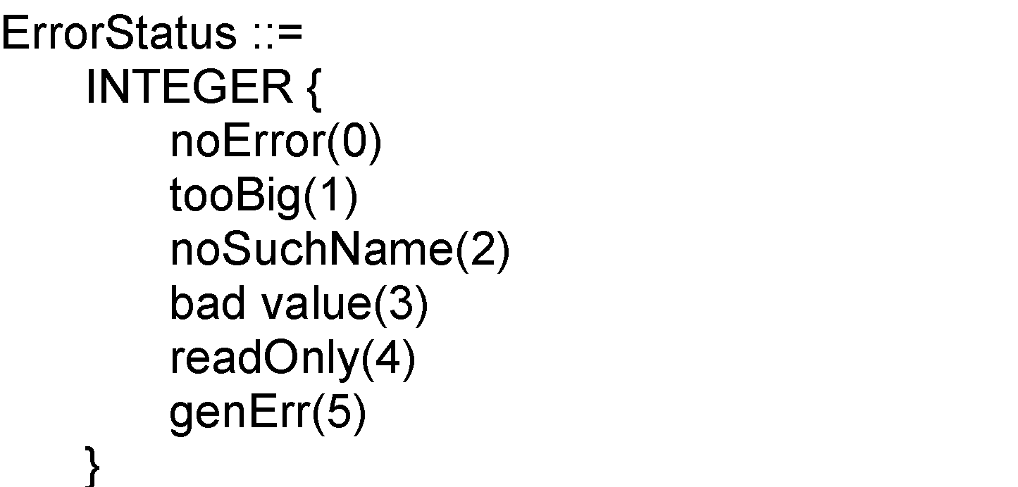
Chapter 5 SNMPv1 Network Management: Communication and Functional Models
Error in Response
Error Index: No. of VarBind that the first error occurred
Notes
The reverse process goes on at the receiver. The message is discarded if an error is encountered in
any of the steps. A trap may be generated in case of authentication failure. On successful receipt of the
message, a return message is generated, if the original message is a get-request.

Slide 16
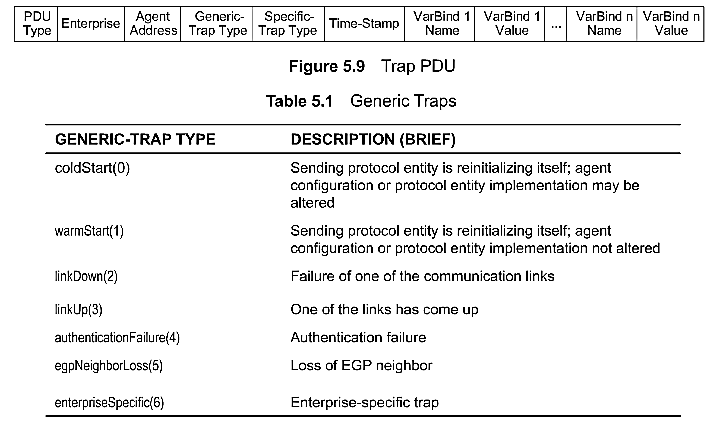
Chapter 5 SNMPv1 Network Management: Communication and Functional Models
Trap PDU
Figure 5.9 shows the structure for a trap PDU, which contains n VarBinds, i.e., n managed objects.
The enterprise [RFC 1155] and agent-address pertain to the system generating the trap.
The generic-trap consists of seven types as listed in Table 5.1. The integer in parenthesis associated with each name indicates the enumerated INTEGER.
The specific-trap is a trap that is not covered by the enterprise Specific trap.
Time-stamp indicates the elapsed time since last re-initialization.
Notes
Enterprise and agent address pertain to the system generating the trap
Seven generic traps specified by enumerated INTEGER
Specific trap is a trap not covered by enterprise specific trap
Timestamp indicates elapsed time since last re-initialization

Slide 17
Chapter 5 SNMPv1 Network Management: Communication and Functional Models
SNMP Operations
SNMP operations comprise get and set messages from the manager to the agent, and get and trap messages from the agent to the manager. We will now look at these operations in detail in this section.
GetRequest PDU Operation. Figure 5.10 shows a sequence of operations in retrieving the values of objects in a System group. It starts with the get-request operation using a GetRequest PDU from a manager process to an agent process and the get-response from the agent with a GetResponse PDU.
The sequence of directed messages moves with time as we move down the figure. Messages depicted represent the values of the seven objects in the System group. The manager process starts the sequence in Figure 5.10 with a GetRequest PDU for the object sysDescr. The agent process returns a GetResponse PDU with a value "SunOS." The manager then sends a request for sysObjectID and receives the value "E:hp." The exchange of messages goes on until the value of 72 for the last object in the group sysServices is received.

Slide 18
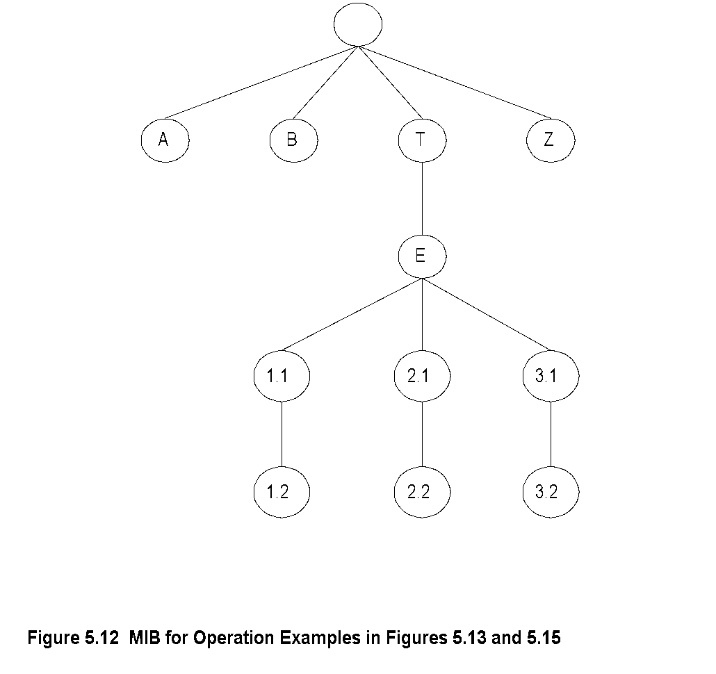
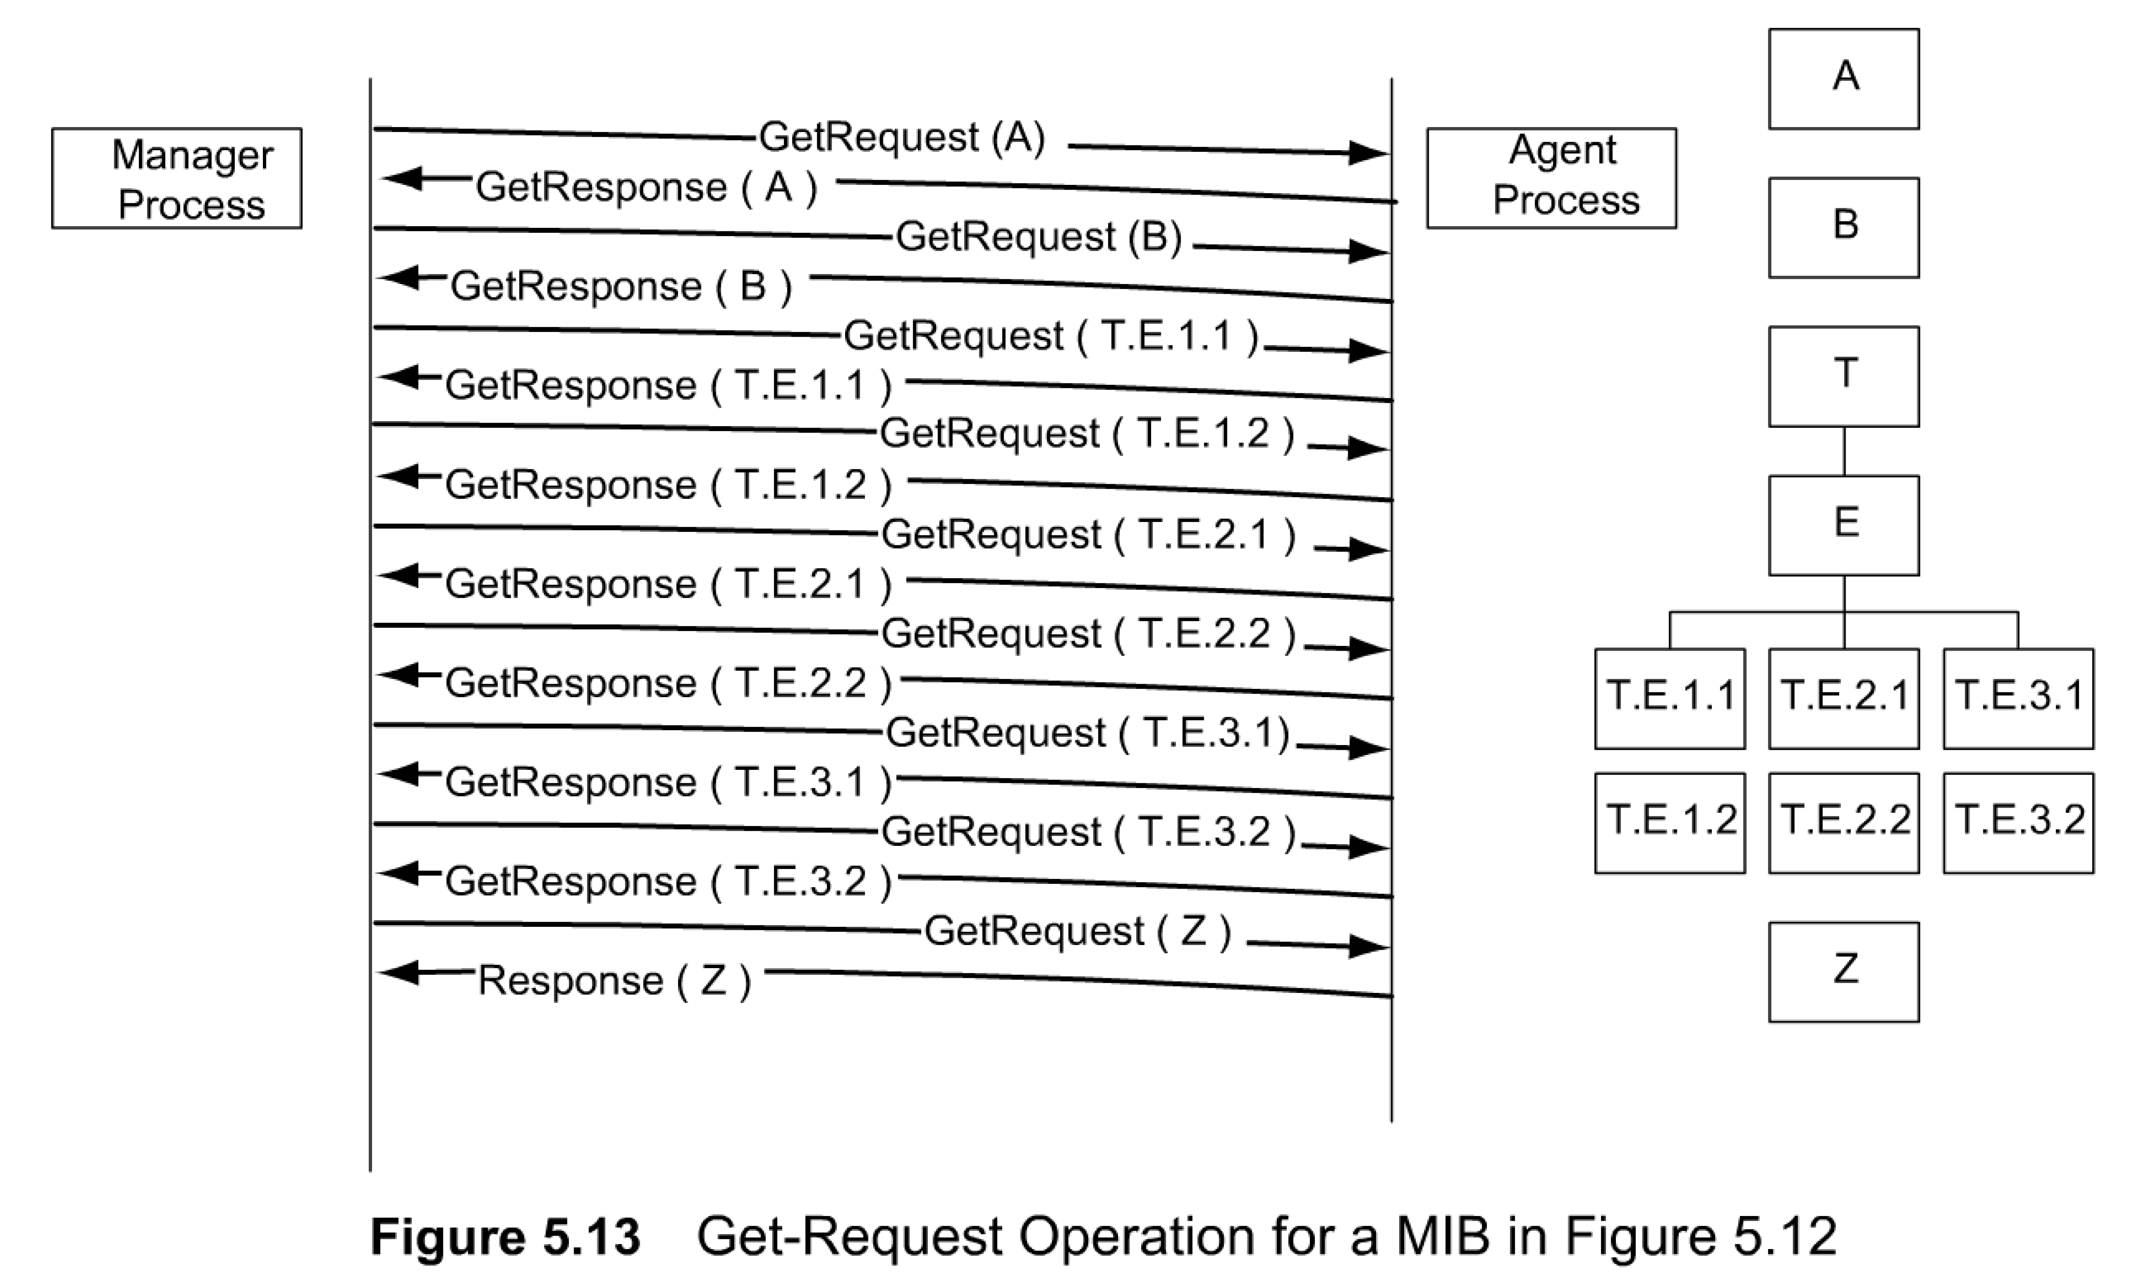
Chapter 5 SNMPv1 Network Management: Communication and Functional Models
MIB for Get-Next-Request
GetNextRequest PDU Operation, is very similar to get-request, except that the requested record is the next one to the OBJECT IDENTIFIER specified in the request.
The System group example we just looked at is a simple case where all the objects are single-valued scalar objects.
Let us now consider a more complex scenario of a MIB that contains both scalar and aggregate objects. A generalized case of a conceptual MIB comprising three scalar objects and a table is shown in Figure 5.12.
The First two objects A and B are single-valued scalar objects. They are followed by an aggregate object represented by the table T with an entry E and two rows of three columnar objects, T.E.1.1. through T.E.3.2. The MIB group ends with a scalar object Z.
Figure 5.13 shows the use of nine get-request messages to retrieve the nine objects. The left side of the figure shows the sequential operation for getting the MIB shown on the right side of the figure. The MIB shown is the same as in Figure 5.12, now drawn to follow the sequence of operations.
An aggregate object

Slide 19
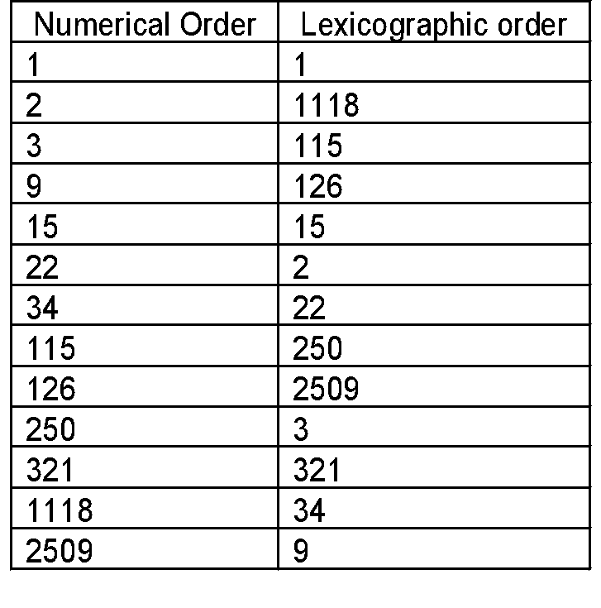
Chapter 5 SNMPv1 Network Management: Communication and Functional Models
Lexicographic Order
Table 5.2
Lexicographic-Order Number Example
The increasing order of entity used in SNMP operations is in lexicographic order.
Let us understand lexicographic order by considering a simple set of integers shown in Table 5.2. The left side is a sequence of numerically increasing integer numbers, and the right side is lexicographically increasing order for this sequence.
We notice that in the lexicographic order, we start with the lowest integer in the leftmost character, which in our case is 1. Before increasing the order in the first position, we select the lowest integer in the second position from the left, which is 11. There are two numbers (1118 and 115) that start with 11. We anchor at 1 1 for the first two positions and then move on to select the lowest digit in the third position, which is 111. We then move to the fourth position and obtain 1118 as the second number. Now, return to the third position and retrieve 115 as the third number. Having exhausted 1s (ones) in positions two to four, select 2 for the second position, and retrieve 126 as the next number. We continue this process until we reach 9.
Notes
Procedure for ordering:
  Start with leftmost digit as first position
  Before increasing the order in the first position, select the lowest digit in the second position
  Continue the process till the lowest digit in the last position is captured
  Increase the order in the last position until all the digits in the last position are captured
  Move back to the last but one position and repeat the process
  Continue advancing to the first position until all the numbers are ordered
Tree structure for the above process

Slide 20
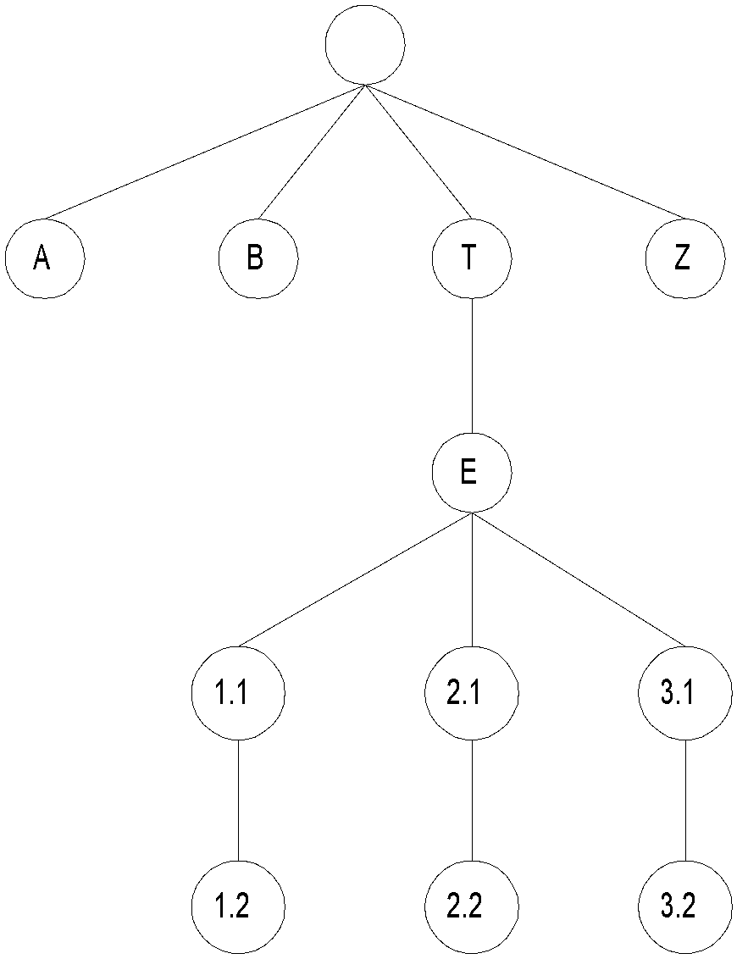
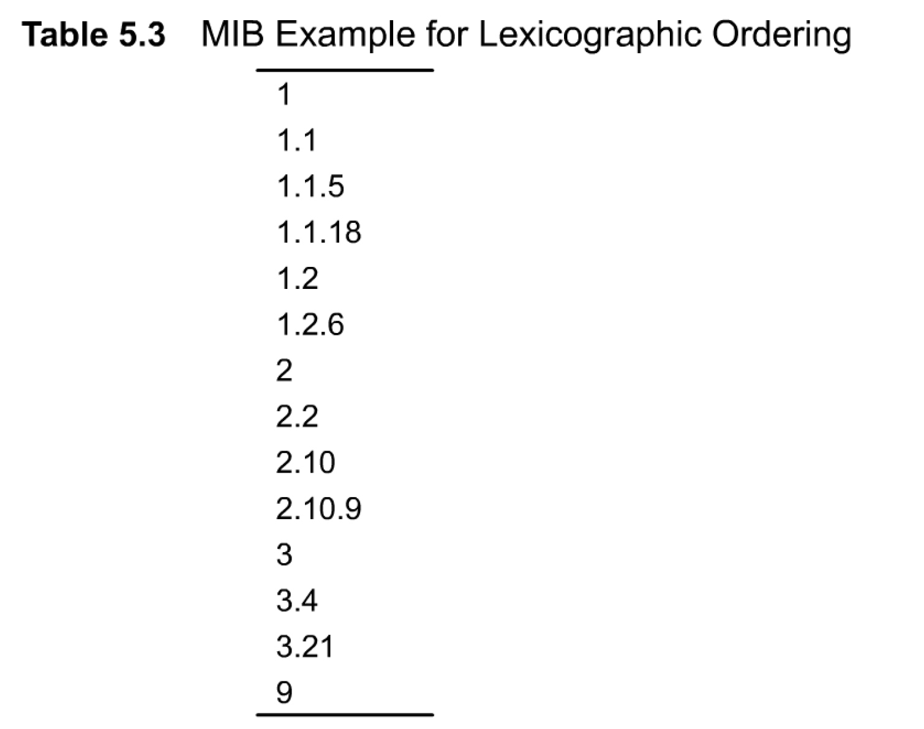
Chapter 5 SNMPv1 Network Management: Communication and Functional Models
MIB Lexicographic Order
We will now apply the lexicographic sequence to ordering object identifiers in a MIB. Instead of each character being treated as a literal, we treat each node position as a literal and follow the same
Figure 5.12 MIB for Operation Examples in Figures 5.13 and 5.15
Notes
A 3.1
B 3.2
T Z
E
1.1
1.2
2.1
2.2

Slide 21
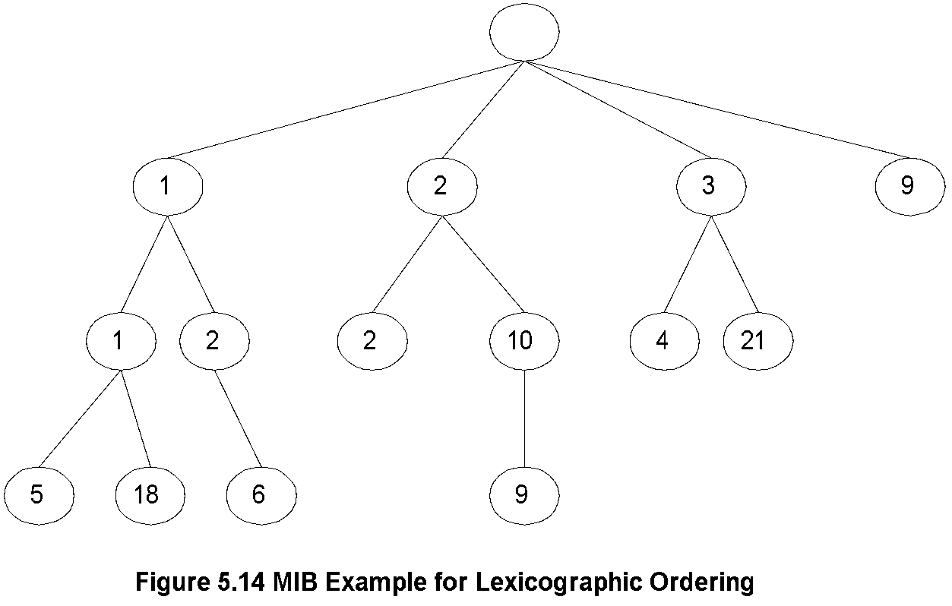
Chapter 5 SNMPv1 Network Management: Communication and Functional Models
A More Complex MIB Example
The MIB associated with this example is shown in Figure 5.14. It can be noticed that the lexicographically increasing order of node traces the traversal of the tree starting from the leftmost node 1. We traverse down the path all the way to the leftmost leaf 1.1.5, keeping to the right whenever a fork is encountered. We then move up the tree and take a right on the first fork. This leads us to the leaf node 1.1.18. Thus, the rule at a forked node is to always keep to the right while traversing down and while going up. Thus, we are always keeping to the right if you imagine ourselves walking along the tree path and looking in the forward direction. We turn around when we reach a leaf.
Returning to get-next-request operation, the get-response message contains the value of the next lexicographic object value in each VarBind. If the request VarBind contains a scalar, non-tabular object, he response contains the next scalar, non-tabular value, or the first columnar object value of a table, if it is the next lexicographic entity.
Notes

Slide 22
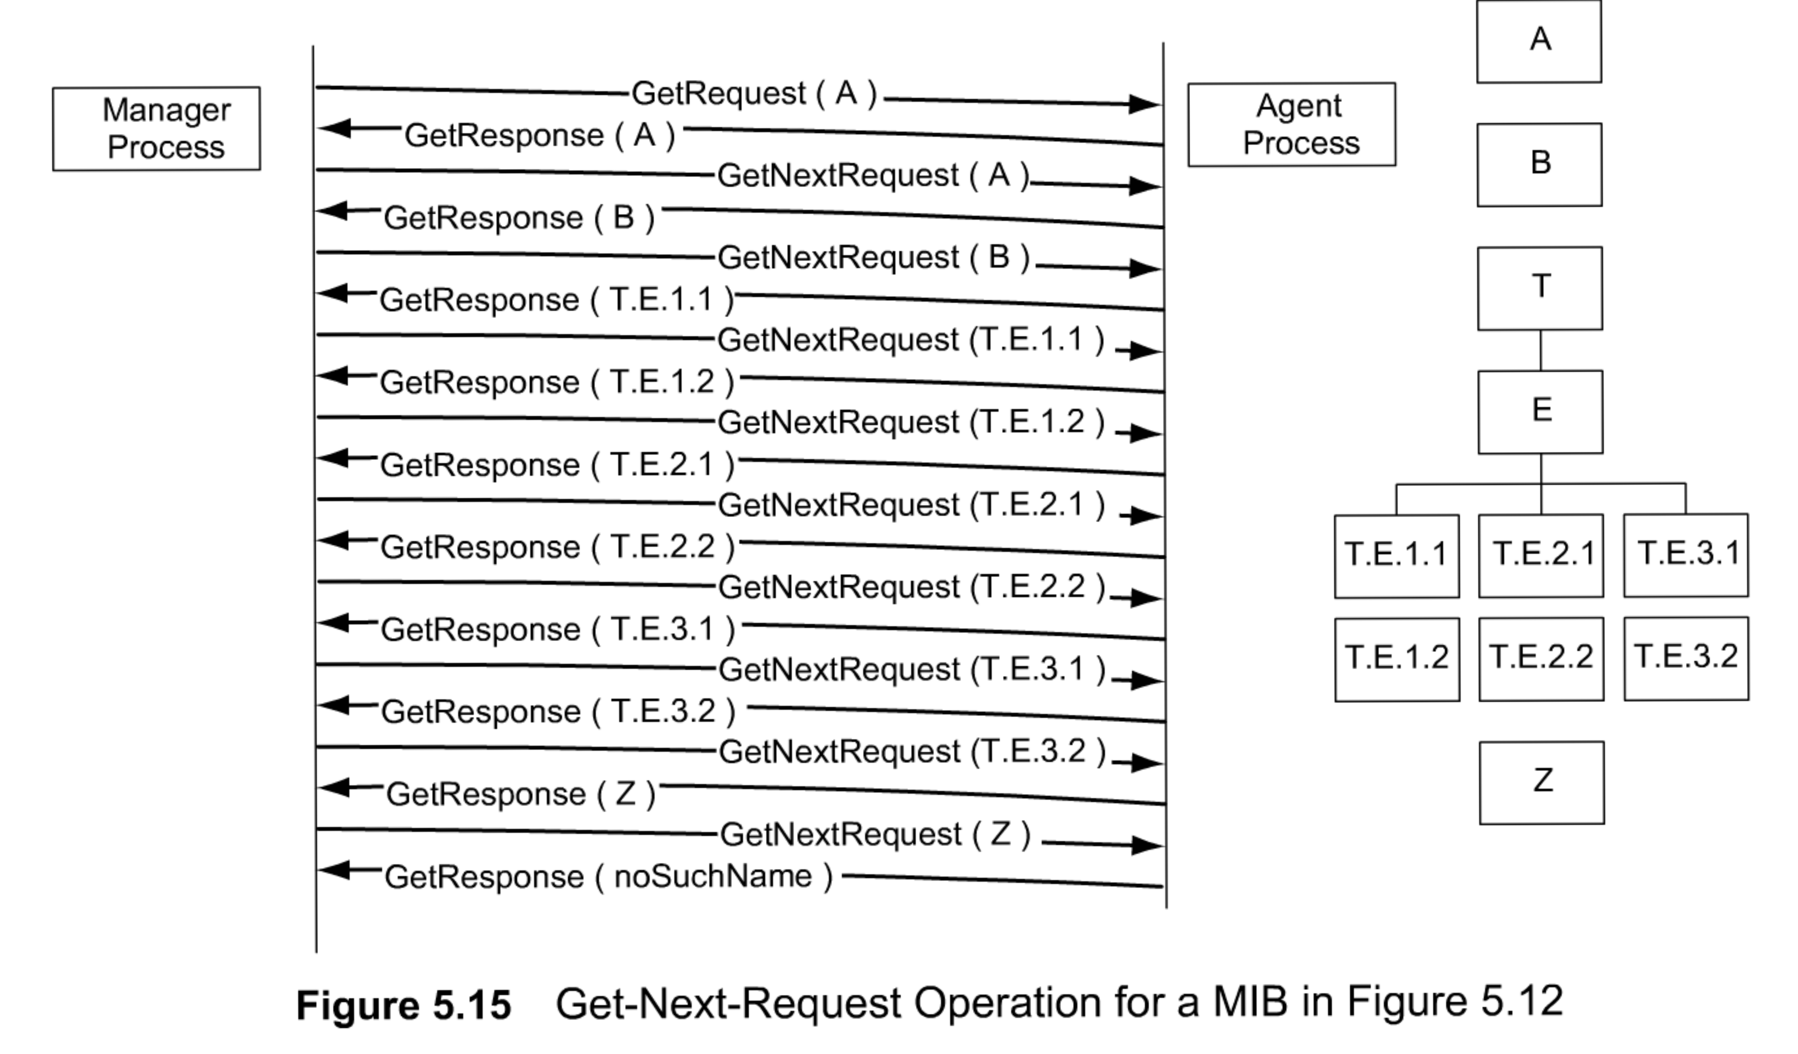
Chapter 5 SNMPv1 Network Management: Communication and Functional Models
Get-Next-Request Operation
Notes
Figure 5.15 shows the principle of operation of the functioning of get-next-request and response.
We use the same MIB view that we had in Figure 5.12 using get-request operation. The manager process starts the operation with a get-request message for object A and receives the response with the value of A filled in.
Subsequent requests from the manager are get-next-request type with the object ID of the just received ones. Responses received are the next object ID with its value. Operations continue until Z is received. The subsequent request receives a response with an error message "noSuchName.“

Slide 23
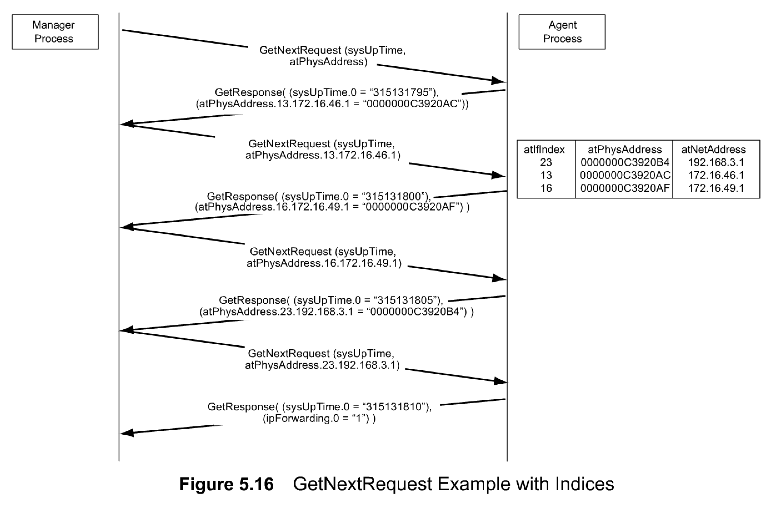
Chapter 5 SNMPv1 Network Management: Communication and Functional Models
Get-Next-Request Operation
There are several advantages in using get-next-request.
First, we do not need to know the object identifier of the next entity. Knowing the current OBJECT IDENTIFIER, we can retrieve the next one.
Next, in the case of an aggregate object, the number of rows is dynamically changing. Thus, we do not know how many rows exist in the table. The get-next-request resolves this problem.
There is also another advantage of the get-next-request. We can use this to build a MIB tree by repeating the request from any node to any node. This is called MIB walk, and is used by a MIB browser in NMS implementation.
Figure 5.16 shows a faster method to retrieve an aggregate object. It shows an Address Translation table with a matrix of three columnar objects, atlflndex, atPhysAddress, and atNetAddress.

Slide 24
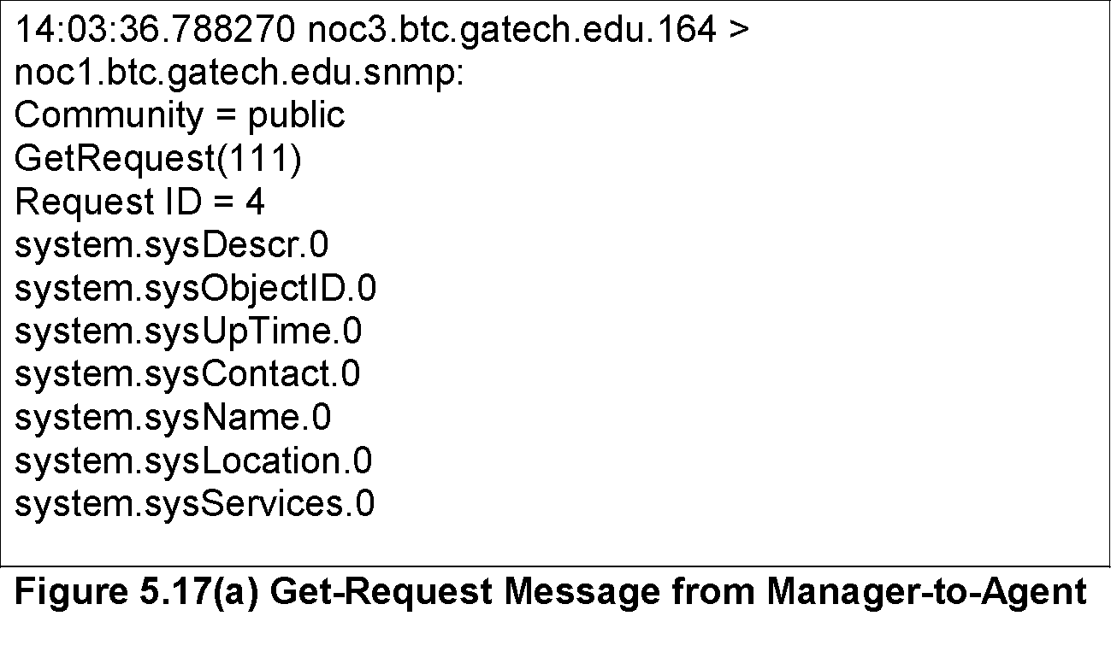
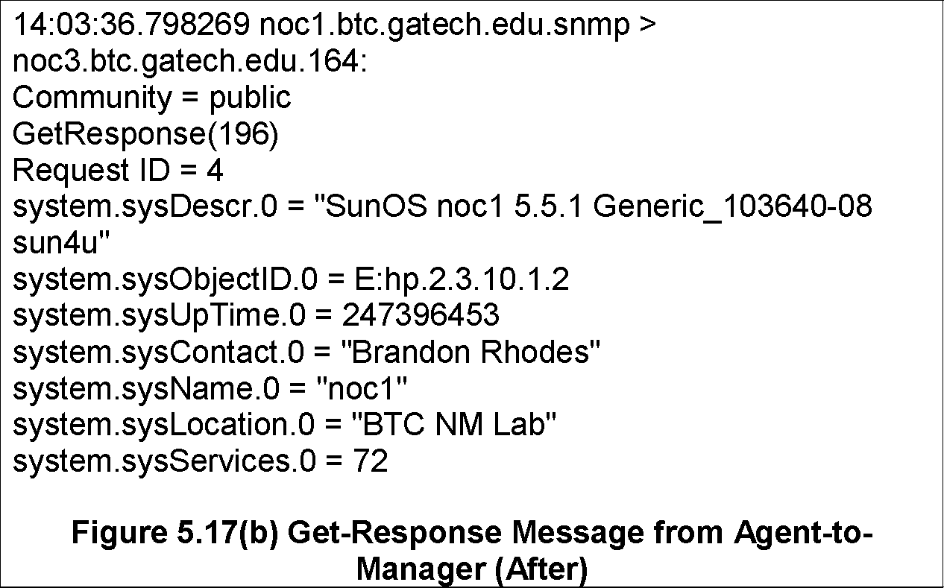
Chapter 5 SNMPv1 Network Management: Communication and Functional Models
Sniffer Data
We will now look at the PDU for the System group example shown in Figure 5. 10 using a sniffer tool. Sniffer is a management tool that can capture packets going across a transmission medium. We have used this tool to "sniff some SNMP messages to display how messages actually look. We are presenting a series of messages that query a system for its system group data (Figure 5.17). This corresponds to the data shown in Figure 5.10.
Figure 5.17(a) shows a GetRequest message for the system group values going from the manager, noc3.gatech.btc.gatech.edu (noc3, for short), to the agent, nocl.btc.gatech.edu (noc3, for short). The first line shows that it was sent at 13:55:47 from port 164 of noc1 to snmp port of noc3. The tool that was used has actually translated the conventional port number 161 to snmp. The community name is public and the GetRequest message is 1 11 bytes in length. The SNMP version number is not filled in.
The seven object IDs from system.sysDescr.O to system.sysServices.O all end with zero to indicate that they are single-valued scalar objects. The agent, noc1, sends a GetResponse message of 172 bytes with values filled in for all seven objects. The GetResponse message is shown in Figure 5.17(b). Notice that the values for sysContact and sysLocation in GetResponse are blank as they have not been entered in the agent. In addition, the request number identified in the GetResponse PDU is the same as the one in the GetRequest PDU.

Slide 25
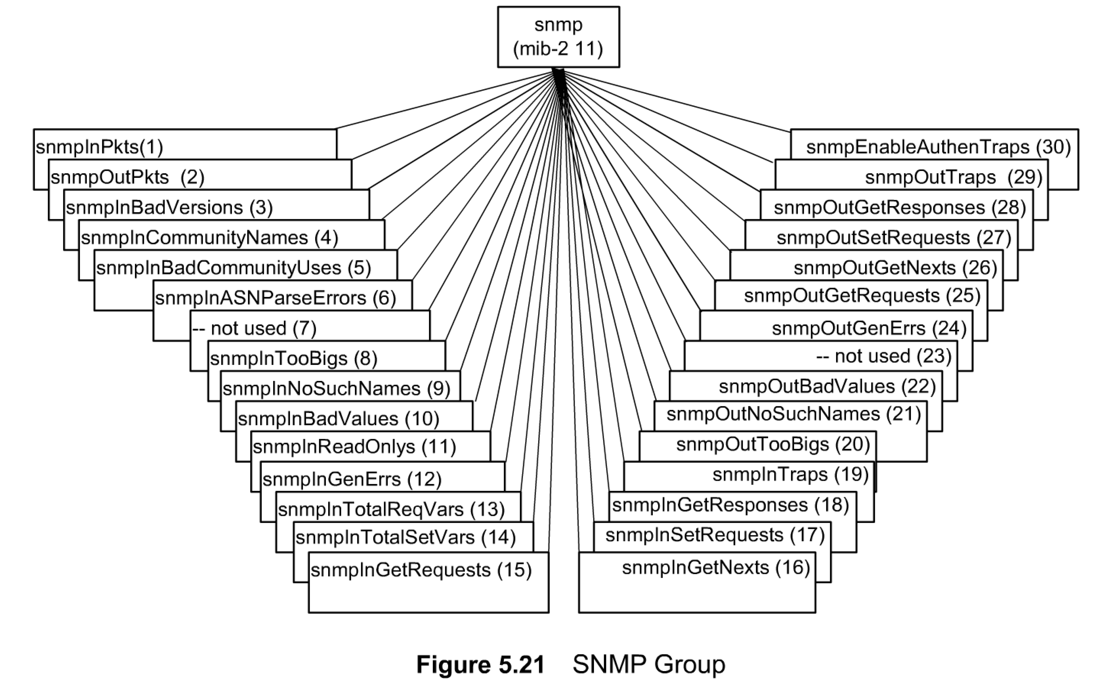
Chapter 5 SNMPv1 Network Management: Communication and Functional Models
SNMP MIB
Notes
SNMPv1 MIB has too many objects that are not used
SNMPv2 obsoleted a large number of them
SNMP MIB Group
Figure 5.21 shows the MIB tree for the SNMP group, and Table 5.4 (in the book) gives the description of the entities. Note that OID 7 and OID 23 are not used. The number of transactions in the description column in the table indicates ins and outs of the SNMP protocol entity.
All entities except snmpEnableAuthenTraps have the syntax, Counter. The implementation of the SNMP group is mandatory—obviously!

Slide 26
5.2 FUNCTIONAL MODEL
There are no formal specifications of functions in SNMPvl management. Application functions are limited, in general, to network management in SNMP and not to the services provided by the network.
There are five areas of functions (configuration, fault, performance, security, and accounting) addressed by the OSI mode. Some configuration functions, as well as security and privacy-related issues, were addressed as part of the SNMP protocol entity specifications in the previous section. For example, the override function of traps is one of the objects in the SNMP group, which has the access privilege of read and write and hence can be set remotely. Security functions are built in as part of the implementation of the protocol entity. Community specifications and authentication scheme partially address these requirements.
The write access to managed objects is limited to implementation in most cases. Thus, configuration management in general is addressed by the specific network management system or by the use of console or telnet to set configurable parameters. We saw the use of the configuration management function in the examples shown in Figures 5.18 and 5.19.
Fault management is addressed by error counters built into the agents. They can be read by the SNMP manager and processed. Traps are useful to monitor network elements and interfaces going up and down.
Performance counters are part of the SNMP agent MIB. Itis the function of the SNMP manager to do performance analysis. For example, counter readings can be taken at two instances of time and the data rate calculated. The intermediate manager/agent, such as RMON, can perform such statistical functions, as we will see in the next chapter.
The administrative model in protocol entity specifications addresses security function in basic SNMP.
The accounting function is not addressed by the SNMP model.

Slide 27
Summary
All management operations are done using five messages in SNMPvl.
They are get-request, get-next-request, set-request, get-response, and trap.
The first three are sent from the manager to the agent and the last two are sent by the agent to the manager.
The SNMP communication model deals with the administrative structure and the five SNMP message PDUs.
The administrative model defines the community within which messages can be exchanged. It also defines the access policy as to who has access privilege to what data.
The five protocol entities are defined in ASN.1 format and macros. We learned SNMP operations by tracing messages exchanged between manager and agent processes. We then looked inside PDU formats for various messages to learn the data formats.
There is no formal specification for the functional model in SNMP management. However, management functions are accomplished by built-in schemes and managed objects. The administrative model in SNMP and the operations using managed objects are employed to accomplish various functions.

